Slide 1
Project 1 GUI Simple Calculator
Python offers multiple options for developing GUI (Graphical User Interface). Out of all the GUI methods, tkinter is the most commonly used method. It is a standard Python interface to the Tk GUI toolkit shipped with Python. Python with tkinter outputs the fastest and easiest way to create the GUI applications. Creating a GUI using tkinter is an easy task.

Slide 2
Basic steps:
First we create an object named root out of tk.
We create an object of the calc and pass root as master to the init method.
Mainloop starts an event loop, which is basically an infinite loop waiting for events and respond accordingly. The mainloop can be terminated by closing the window or using close method.

Slide 3
# importing Tkinter and math
from tkinter import *
import math
# calc class
class calc:
def getandreplace(self):
"""replace x with * and ÷ with /"""
self.expression = self.e.get()
self.newtext=self.expression.replace('/','/')
self.newtext=self.newtext.replace('x','*')

Slide 4
""when the equal button is pressed""
def equals(self):
self.getandreplace()
try:
# evaluate the expression using the eval function
self.value= eval(self.newtext)
except SyntaxError or NameError:
self.e.delete(0,END)
self.e.insert(0,'Invalid Input!')
else:
self.e.delete(0,END)
self.e.insert(0,self.value)

Slide 5
"“Squareroot method""
def squareroot(self):
self.getandreplace()
try:
# evaluate the expression using the eval function
self.value= eval(self.newtext)
except SyntaxError or NameError:
self.e.delete(0,END)
self.e.insert(0,'Invalid Input!')
else:
self.sqrtval=math.sqrt(self.value)
self.e.delete(0,END)
self.e.insert(0,self.sqrtval)

Slide 6
""“Square Method"""
ef square(self):
self.getandreplace()
try:
#evaluate the expression using the eval function
self.value= eval(self.newtext)
except SyntaxError or NameError:
self.e.delete(0,END)
self.e.insert(0,'Invalid Input!')
else:
self.sqval=math.pow(self.value,2)
self.e.delete(0,END)
self.e.insert(0,self.sqval)

Slide 7
""when clear button is pressed,clears the text input area""
def clearall(self):
self.e.delete(0,END)
def clear1(self):
self.txt=self.e.get()[:-1]
self.e.delete(0,END)
self.e.insert(0,self.txt)
def action(self,argi):
"""pressed button's value is inserted into the end of the text area"""
self.e.insert(END,argi)

Slide 8
""Constructor method""
def __init__(self,master):
master.title('Calculator')
master.geometry()
self.e = Entry(master)
self.e.grid(row=0,column=0,columnspan=6,pady=3)
self.e.focus_set() #Sets focus on the input text area

Slide 9
# Generating Buttons
Button(master,text="=",width=11,height=3,fg="blue",
bg="orange",command=lambda:self.equals()).grid(
row=4, column=4,columnspan=2)
Button(master,text='AC',width=5,height=3,
fg="red", bg="light green",
command=lambda:self.clearall()).grid(row=1, column=4)
Button(master,text='C',width=5,height=3,
fg="red",bg="light green",
command=lambda:self.clear1()).grid(row=1, column=5)

Slide 10
utton(master,text="+",width=5,height=3,
fg="blue",bg="orange",
command=lambda:self.action('+')).grid(row=4, column=3)
Button(master,text="x",width=5,height=3,
fg="blue",bg="orange",
command=lambda:self.action('x')).grid(row=2, column=3)
Button(master,text="-",width=5,height=3,
fg="red",bg="light green",
command=lambda:self.action('-')).grid(row=3, column=3)
Button(master,text="÷",width=5,height=3,
fg="blue",bg="orange",
command=lambda:self.action('/')).grid(row=1, column=3)
Button(master,text="%",width=5,height=3,
fg="red",bg="light green",
command=lambda:self.action('%')).grid(row=4, column=2)
Button(master,text="7",width=5,height=3,
fg="blue",bg="orange",
command=lambda:self.action('7')).grid(row=1, column=0)

Slide 11
Button(master,text="8",width=5,height=3,
fg="red",bg="light green",
command=lambda:self.action(8)).grid(row=1, column=1)
Button(master,text="9",width=5,height=3,
fg="blue",bg="orange",
command=lambda:self.action(9)).grid(row=1, column=2)
Button(master,text="4",width=5,height=3,
fg="red",bg="light green",
command=lambda:self.action(4)).grid(row=2, column=0)
Button(master,text="5",width=5,height=3,
fg="blue",bg="orange",
command=lambda:self.action(5)).grid(row=2, column=1)
Button(master,text="6",width=5,height=3,
fg="white",bg="blue",
command=lambda:self.action(6)).grid(row=2, column=2)
Button(master,text="1",width=5,height=3,
fg="red",bg="light green",
command=lambda:self.action(1)).grid(row=3, column=0)

Slide 12
Button(master,text="2",width=5,height=3,
fg="blue",bg="orange",
command=lambda:self.action(2)).grid(row=3, column=1)
Button(master,text="3",width=5,height=3,
fg="white",bg="blue",
command=lambda:self.action(3)).grid(row=3, column=2)
Button(master,text="0",width=5,height=3,
fg="white",bg="blue",
command=lambda:self.action(0)).grid(row=4, column=0)
Button(master,text=".",width=5,height=3,
fg="red",bg="light green",
command=lambda:self.action('.')).grid(row=4, column=1)
Button(master,text="(",width=5,height=3,
fg="white",bg="blue",
command=lambda:self.action('(')).grid(row=2, column=4)
Button(master,text=")",width=5,height=3,
fg="blue",bg="orange",
command=lambda:self.action(')')).grid(row=2, column=5)

Slide 13
Button(master,text="(",width=5,height=3,
fg="white",bg="blue",
command=lambda:self.action('(')).grid(row=2, column=4)
Button(master,text=")",width=5,height=3,
fg="blue",bg="orange",
command=lambda:self.action(')')).grid(row=2, column=5)
Button(master,text="?",width=5,height=3,
fg="red",bg="light green",
command=lambda:self.squareroot()).grid(row=3, column=4)
Button(master,text="x²",width=5,height=3,
fg="white",bg="blue",
command=lambda:self.square()).grid(row=3, column=5)

Slide 14
# Driver Code
root = Tk()
obj=calc(root) # object instantiated
root.mainloop()

Slide 15
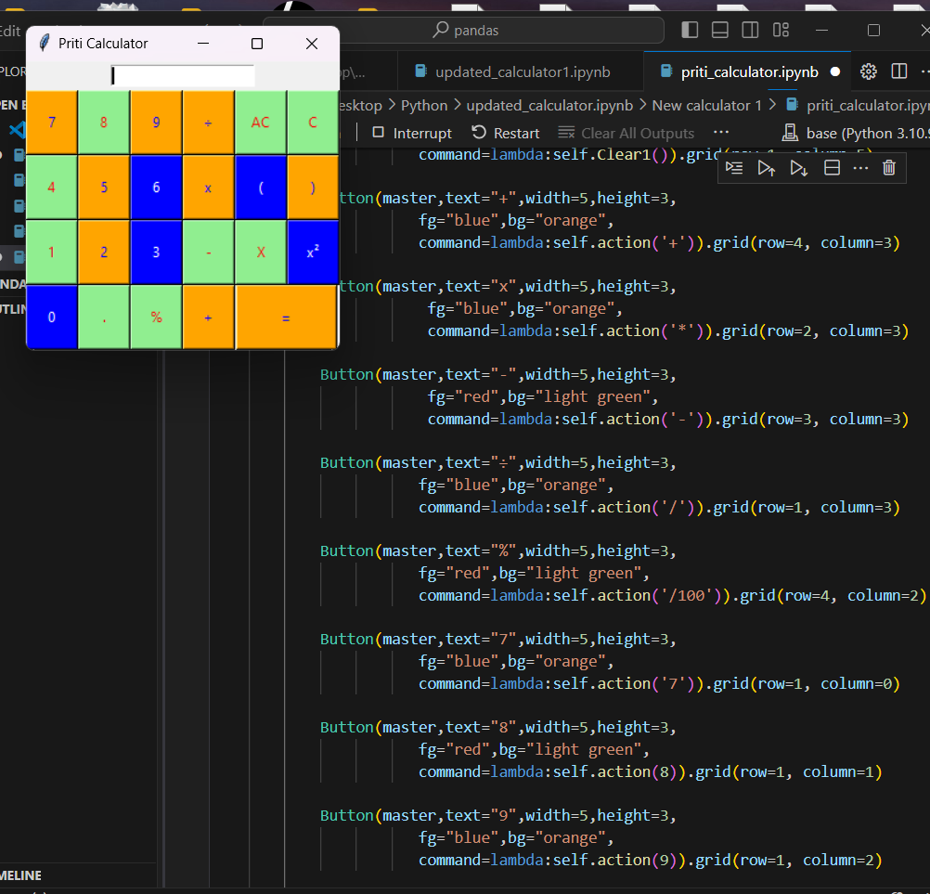
“”Output””

